Slide 1
Continuous carbon capture in an electrochemical solid-electrolyte reactor
May 2 2024
Decaln Lim (116111401)

Slide 2
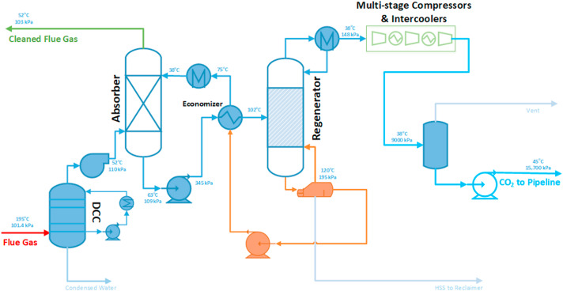
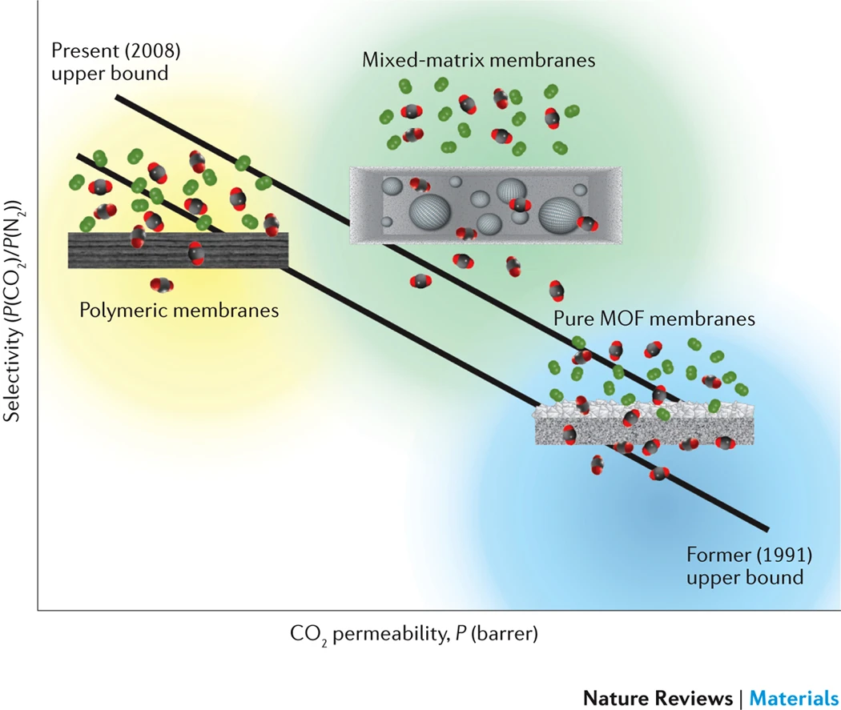
Introduction
Greenhouse gases need to decrease due to rapid climate change. So, Carbon capture is one of the good methods.
Schematic of a conventional configuration for amine-based PCC.
The relationship between the CO2/N2 gas pair selectivity and CO2 permeability
Existing carbon capture technologies rely on high-energy thermal processes or suffer from reduced stability when exposed to humidity.
https://doi.org/10.1016/j.clet.2021.100249 https://www.nature.com/articles/natrevmats201745#Abs1

Slide 3
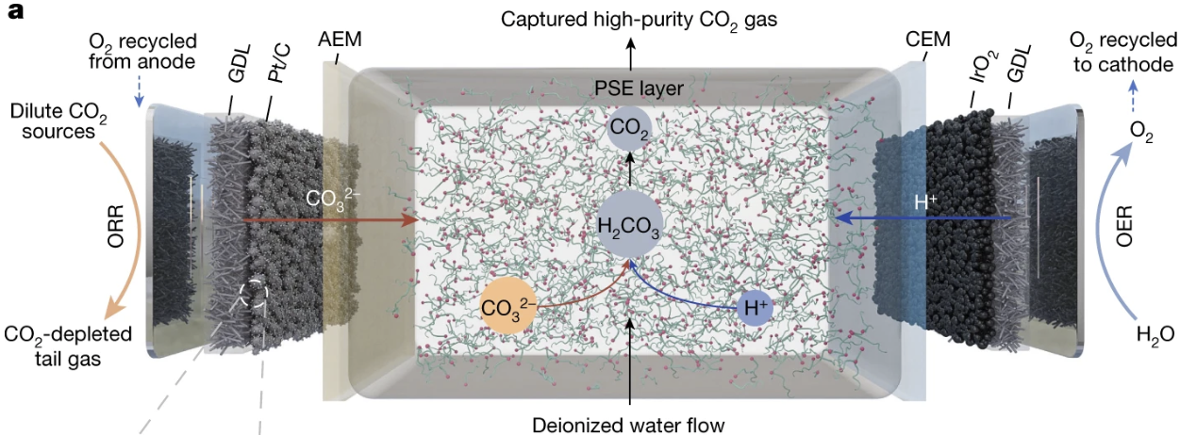
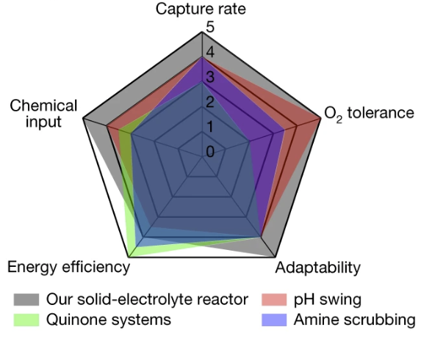



Background
Different carbon-capture design by coupling O2/H2O electrolysis
$ORR: O_{2}+2H_{2}O+4e^{−}=4OH^{−}$
$OER: 2H_{2}O=O_{2}+4H^{+}+4e^{−}$
Schematic of the solid-electrolyte reactor for carbon capture.
A radar plot comparison of different carbon-capture technologies

Slide 4
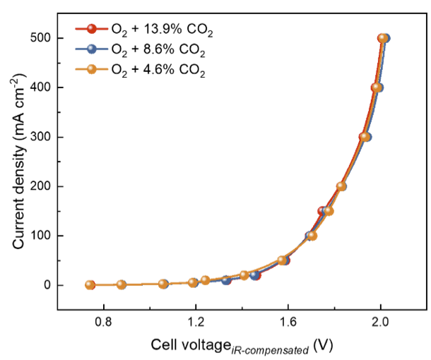
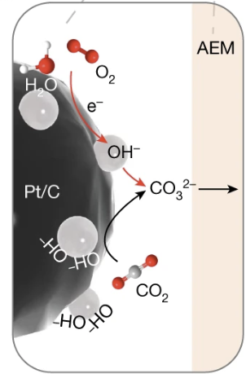
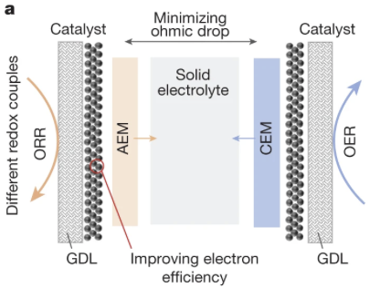


Background
Discussion on ORR/OER I-V curves under various CO2 concentrations.
A new catalyst that can replace expensive Pt/C catalysts.
The efficiency depending on the porous solid-electrolyte thickness.

Slide 5
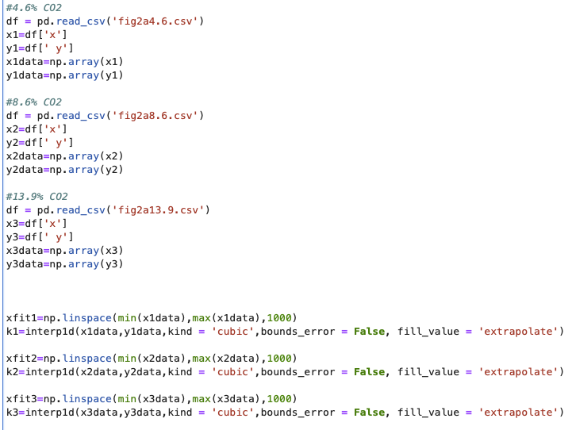
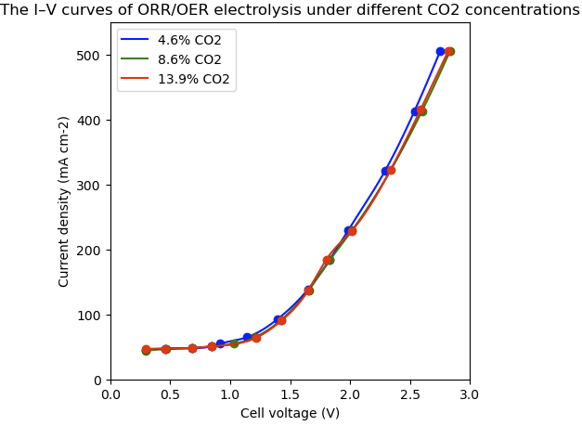
Results & Codes
ORR/OER I-V curves indicating that cell activity is determined by oxygen concentration rather than CO2 concentration.

Slide 6
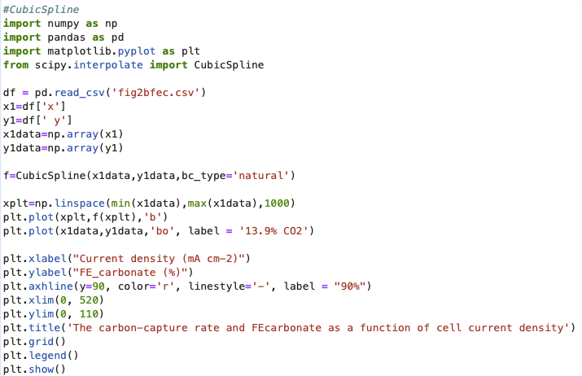
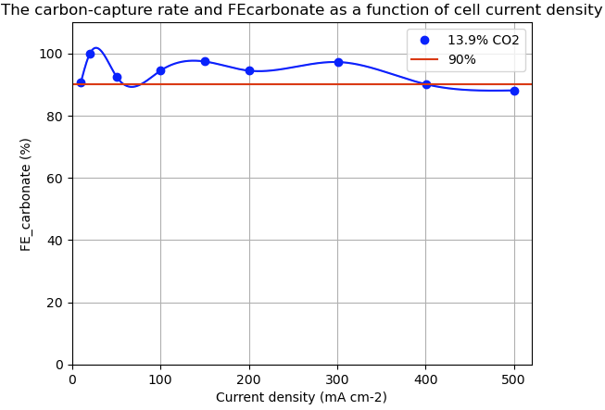
Results & Codes
FEcarbonate maintained above 90% across wide range of cell current ranges under 13.9% CO2, indicating highly efficient utilization of generated ${OH}^{−}$ ions.

Slide 7
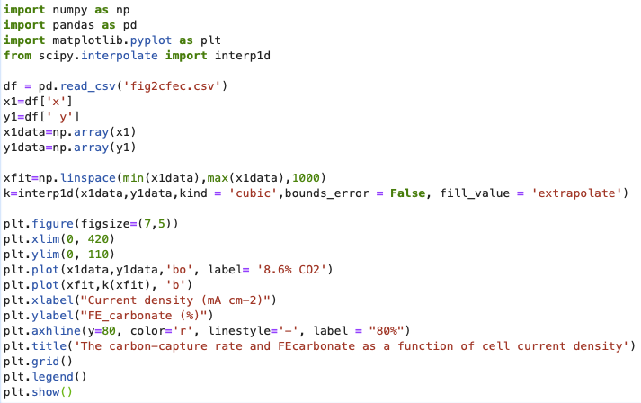
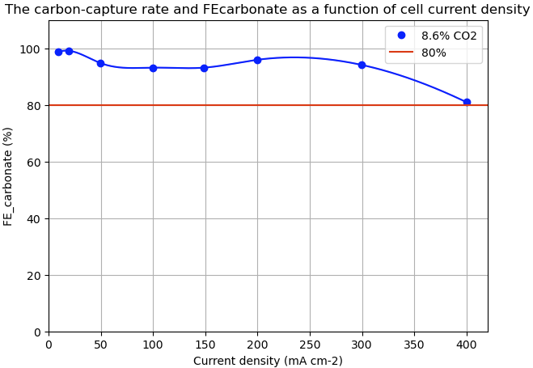
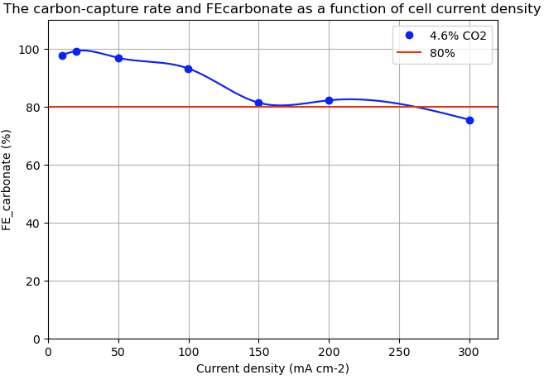
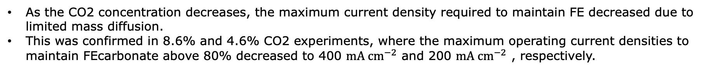
Results & Codes
As the CO2 concentration decreases, the maximum current density required to maintain FE decreased due to limited mass diffusion.
This was confirmed in 8.6% and 4.6% CO2 experiments, where the maximum operating current densities to maintain FEcarbonate above 80% decreased to 400 ${mA cm}^{−2}$ and 200 ${mA cm}^{−2}$ , respectively.

Slide 8
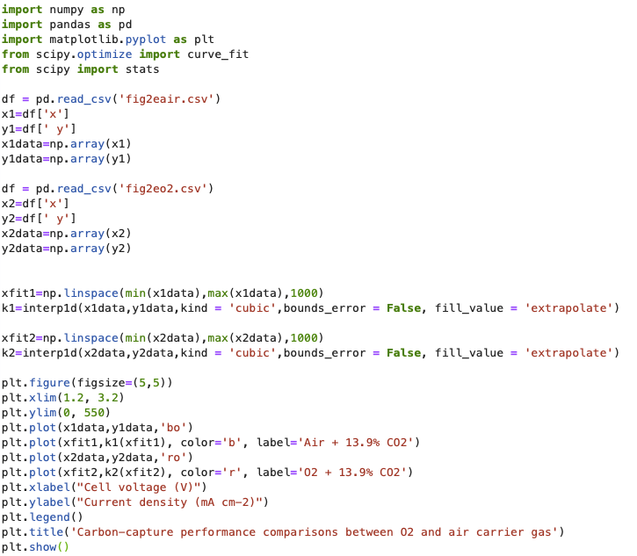
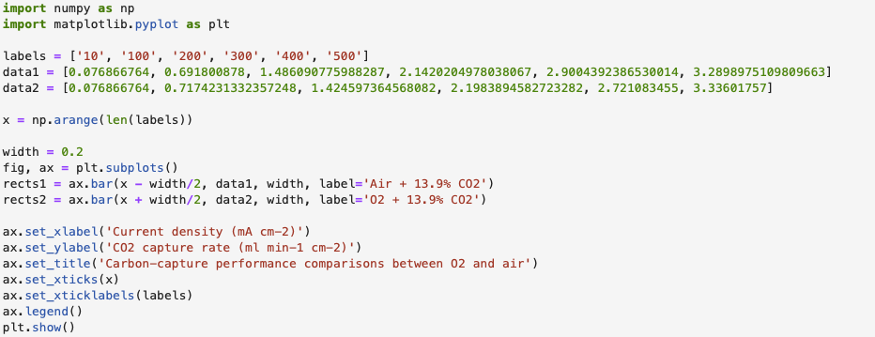
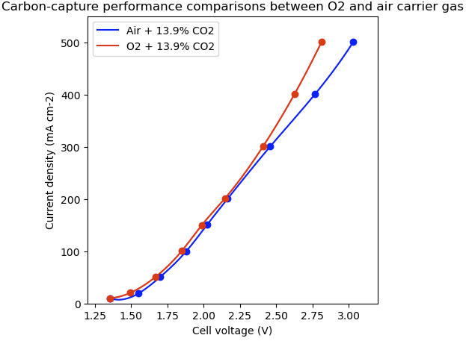
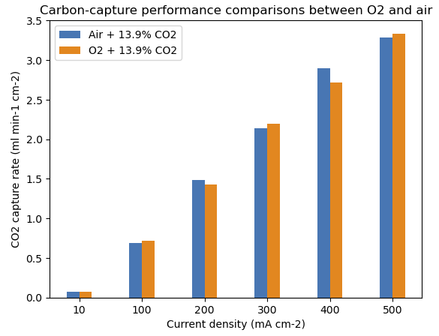
Results & Codes
By the I–V curve comparison, Air + 13.9% CO2 required higher voltage at high current densities due to lower oxygen partial pressure.
This cell voltage difference did not affect current efficiency or CO2 capture rate.

Slide 9
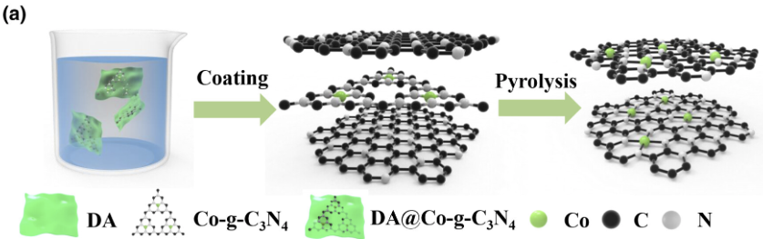
Results & Codes
Pt/C
Co-SAC
https://onlinelibrary.wiley.com/doi/full/10.1002/eem2.12371

Slide 10
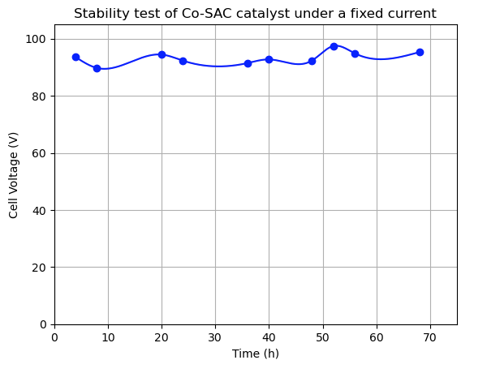
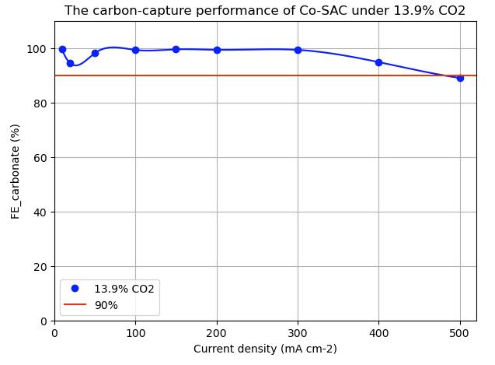
Results & Codes
The I-V curve of Co-SAC showed similar catalyst activity and FEcarbonate compared to Pt/C catalyst.
During 72 hours of continuous carbon capture operation under fixed current density in a solid electrolyte device, it remained unchanged → High stability

Slide 11
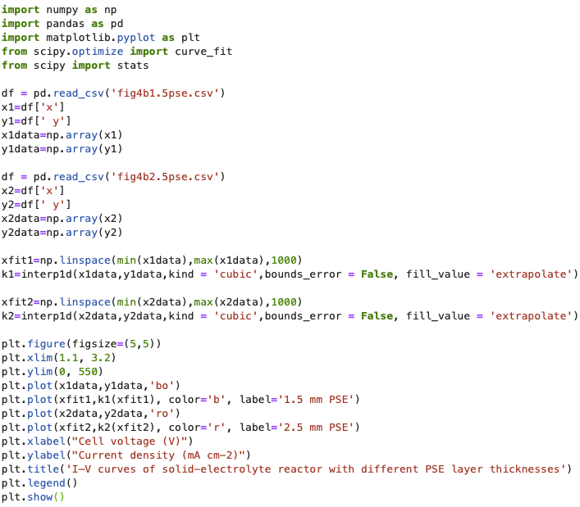
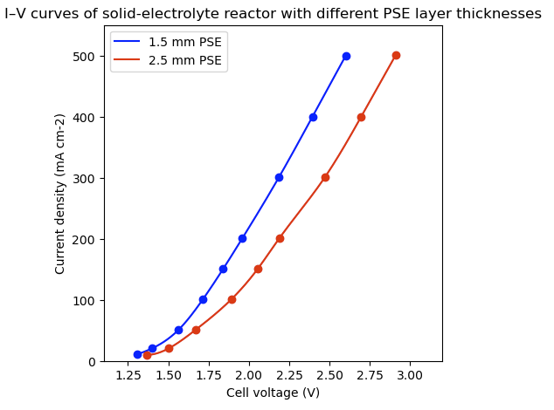
Results & Codes
I–V curves of solid-electrolyte reactor with different PSE layer thicknesses shows improved cell resistance

Slide 12
Conclusion
This solid-state electrolyte reactor presents a versatile carbon capture platform that can be realized through various oxidation-reduction coupling processes.
Various cell and operation parameters can be further optimized as future research directions to improve the carbon-capture energy efficiencies and costs for practical deployments.

Slide 13
Reference
[1] Peng Zhu, Zhen-Yu Wum, Ahmad Elgazzar, Changxin Dong, Tae0Ung Wi, et al, Continuous carbon capture in an electrochemical solid-electrolyte reactor, Nature. 618 (2023), 959-966, https://doi.org/10.1038/s41586-023-06060-1
[2] Ibadillah A. Digdaya, Ian Sullivan, Meng Lin, Lihao Han, Wen-Hui Cheng, et al, A direct coupled electrochemical system for capture and conversion of CO2 from oceanwater, Nature. (2020), 11:4412, https://doi.org/10.1038/s41467-020-18232-y
[3] Christopher A. Trickett, Aasif Helal, Bassem A. Al-Maythalony, Zain H. Yamani, et al, The chemistry of metal–organic frameworks for CO2capture, regeneration and conversion, Nature Reviews Materials. (2017), 17045 doi:10.1038/natrevmats
[4] Feng Li, Gao-Feng Han, Hyuk-Jun Noh, Seok-Jin Kim, Yalin Lu, et al, Boosting oxygen reduction catalysis with abundant copper single atom active sites, EnergyEnviron.Sci. (2018), 11, 2263-2269, DOI: 10.1039/c8ee01169a
[5] Peng Rao, Junming Luo, Daoxiong Wu, Jing Li, Qi Chen, Peilin Deng, et al, Isolated Co Atoms Anchored on Defective Nitrogen-doped Carbon Graphene as Efficient Oxygen Reduction Reaction Electrocatalysts, Energy Environ. Mater.2023,6, e12371, https://doi.org/10.1002/eem2.12371

